Slide 1
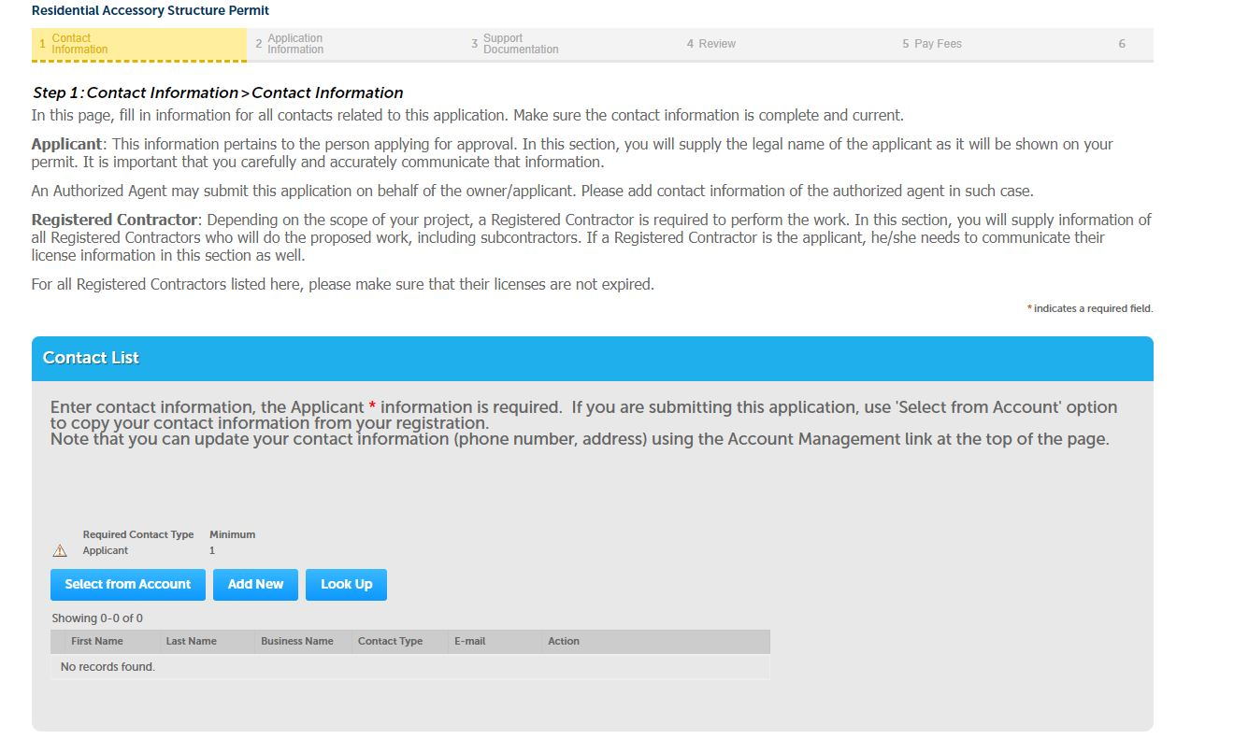
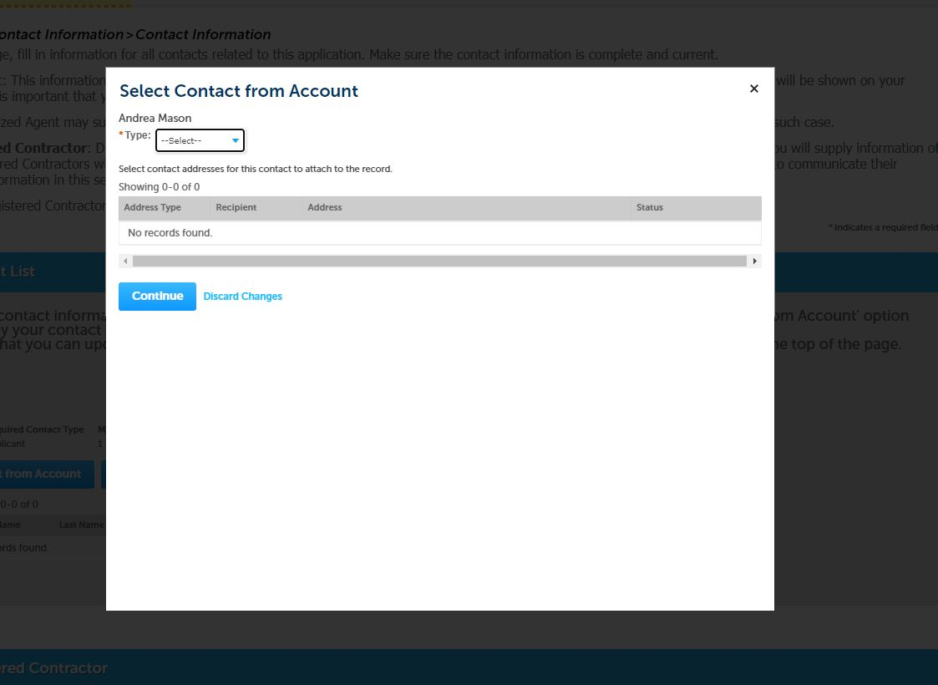
Add contact information from “Select from Account” ,”Add new” or “Look Up”.
Contact can apply as an applicant, authorized agent, billing contact or Property owner. There can be more than one contact. Select “Continue”

Slide 2
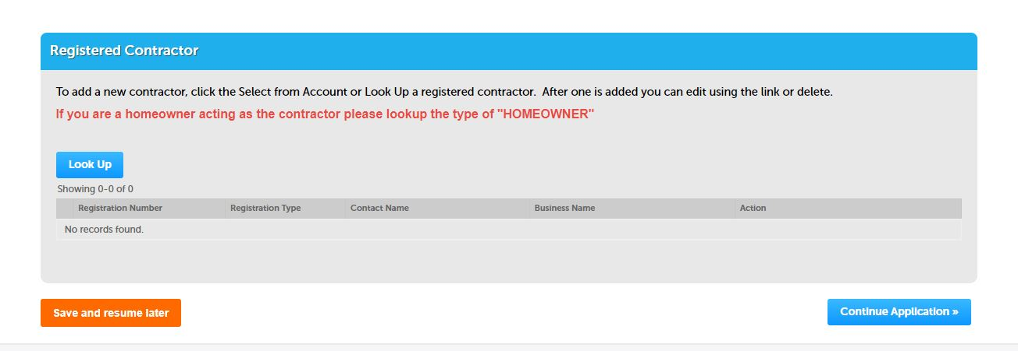
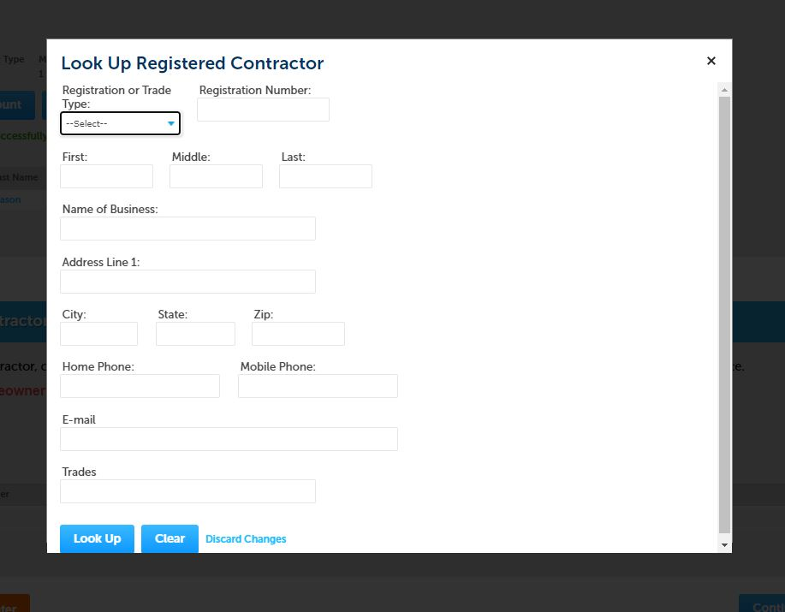
Add registered contractor using “Look UP” button. Homeowner performing their own work can select “Homeowner”
Contactor information can be looked up numerous ways including by name, type, trade or registration number. A list of registered contractors can be found on our website. Once information is filled in, select “Look Up”

Slide 3
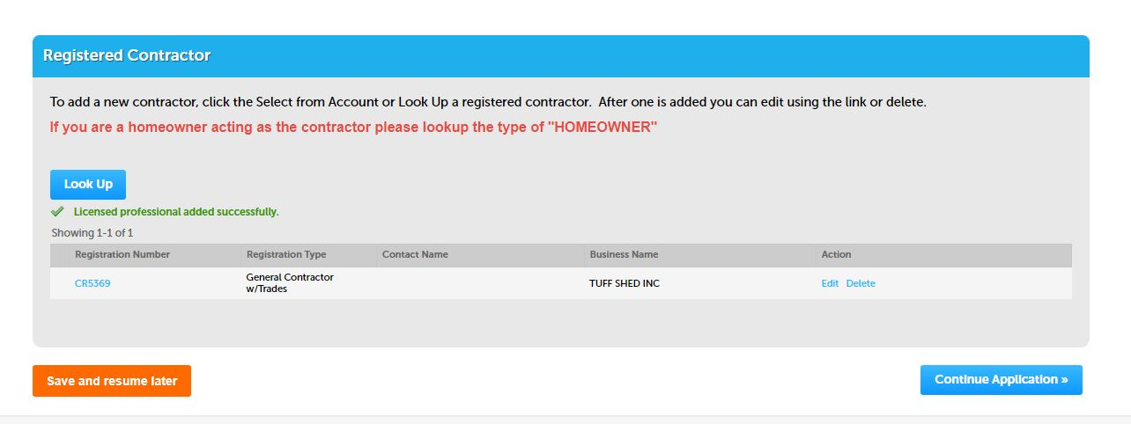
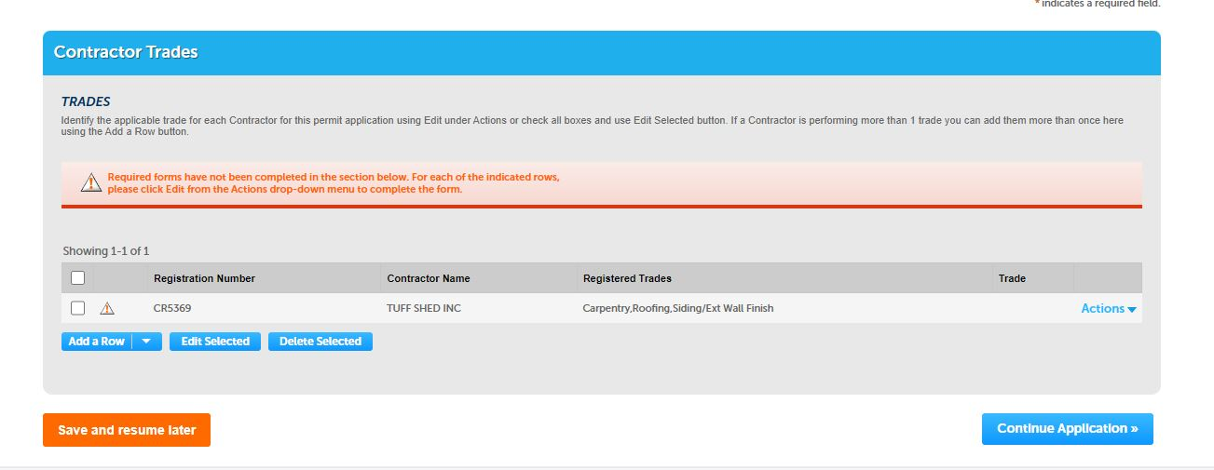
Contractor information will populate fields. Select “Continue Application” to complete further information
Under “Action” , choose edit to add trades or delete if selection is not correct. Applicant can also add more contractors by selecting “Add a Row” and filling with additional contractors or the same contractor doing multiple trades

Slide 4
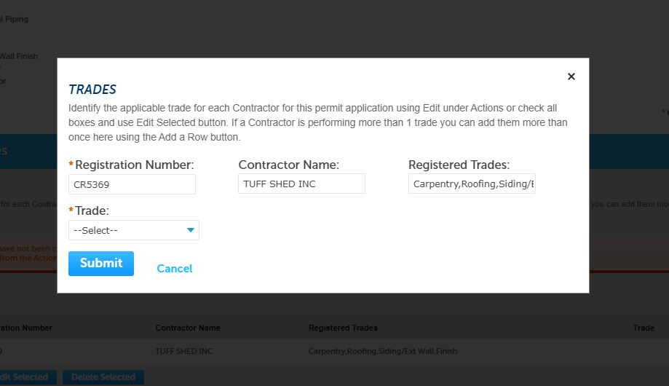
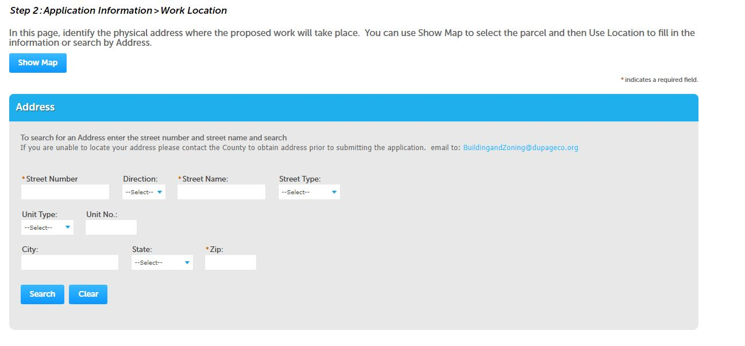
Choose the trade for each contractor. All trades for the scope of work must have a registered trade.
There are two ways to complete the work location field. One is to add property information by searching with the property address. Select “Search”. All subsequent fields will infill.

Slide 5
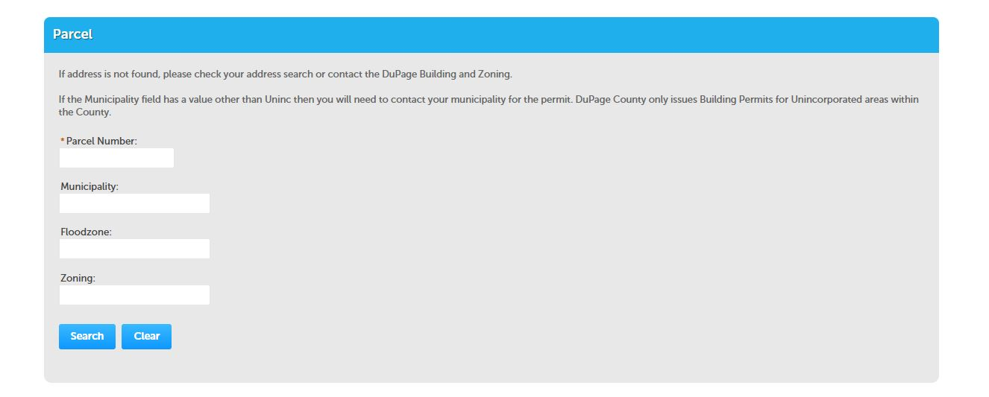
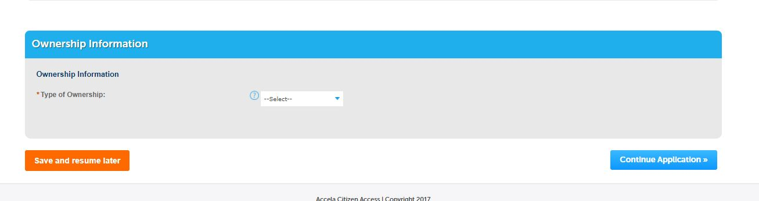
The second way is to add property information by searching with the parcel number. Select “Search”. All subsequent fields will infill.
Select the type of Ownership: Bank/ Trust Company, Family Trust or Individual. If in a trust, a trust disclosure document will be required to complete application. If ownership is an individual or several individuals, no other documents are required. Ownership must match the DuPage County Recorder.

Slide 6
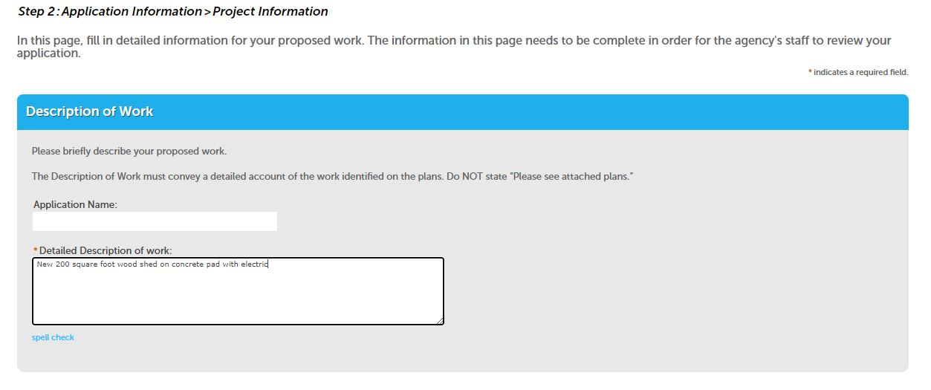
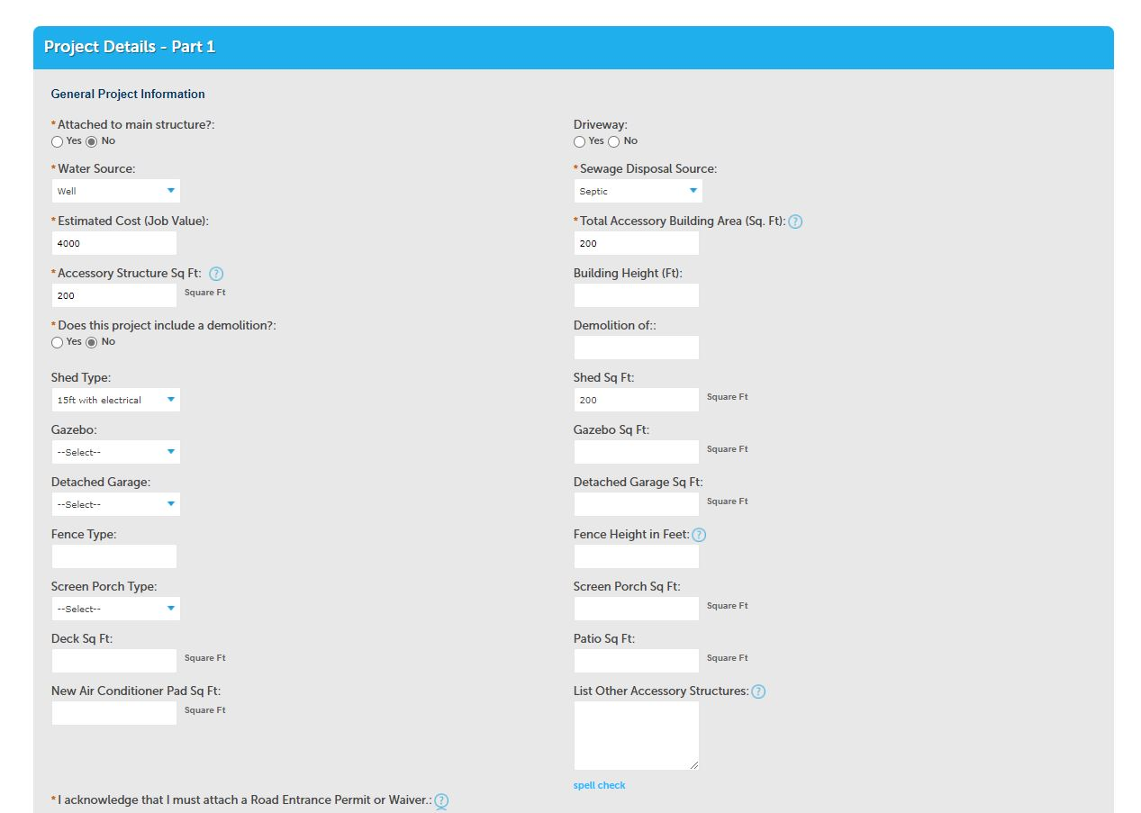
Complete description field with all work being applied for. There may be several accessory structures on one application such as a fence, shed, patio, pool etc.
Complete all required fields with an asterisk. Please fill in optional fields as necessary to clarify work. Blue question mark symbols reveal further information when selected.

Slide 7
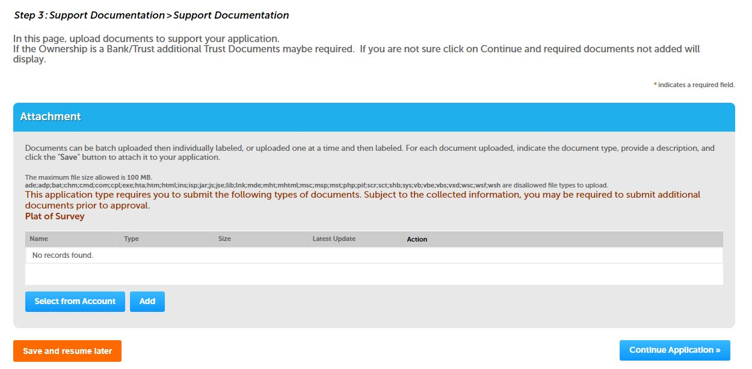
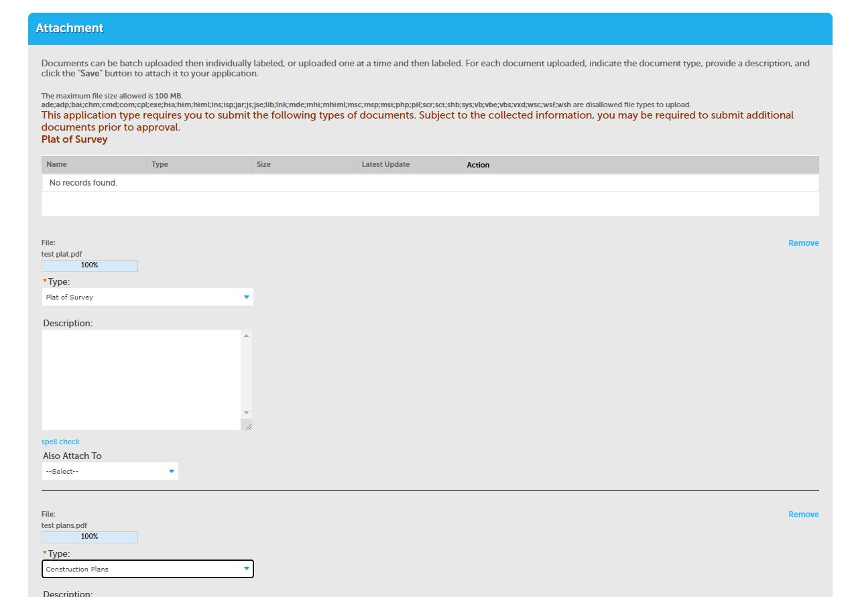
Add the required documents required for review. At minimum, an up-to-date survey must be attached. Construction documents, manufacturer’s specifications or other documents may be required depending on scope. All applications will require an entrance permit prior to permit issuance.
Using pull down menu, select the document type. Add additional documents or if complete, select “Save”

Slide 8
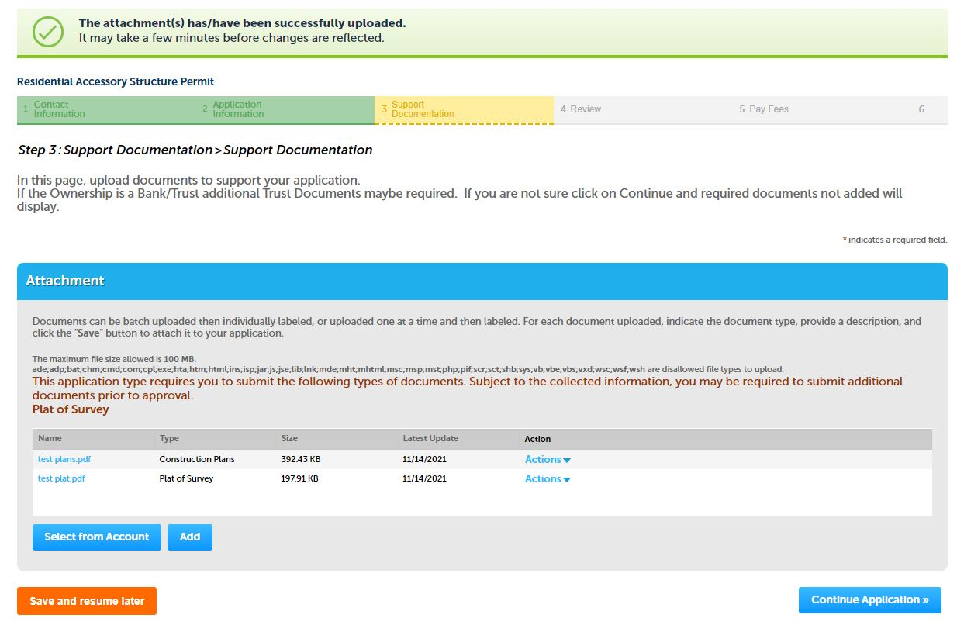
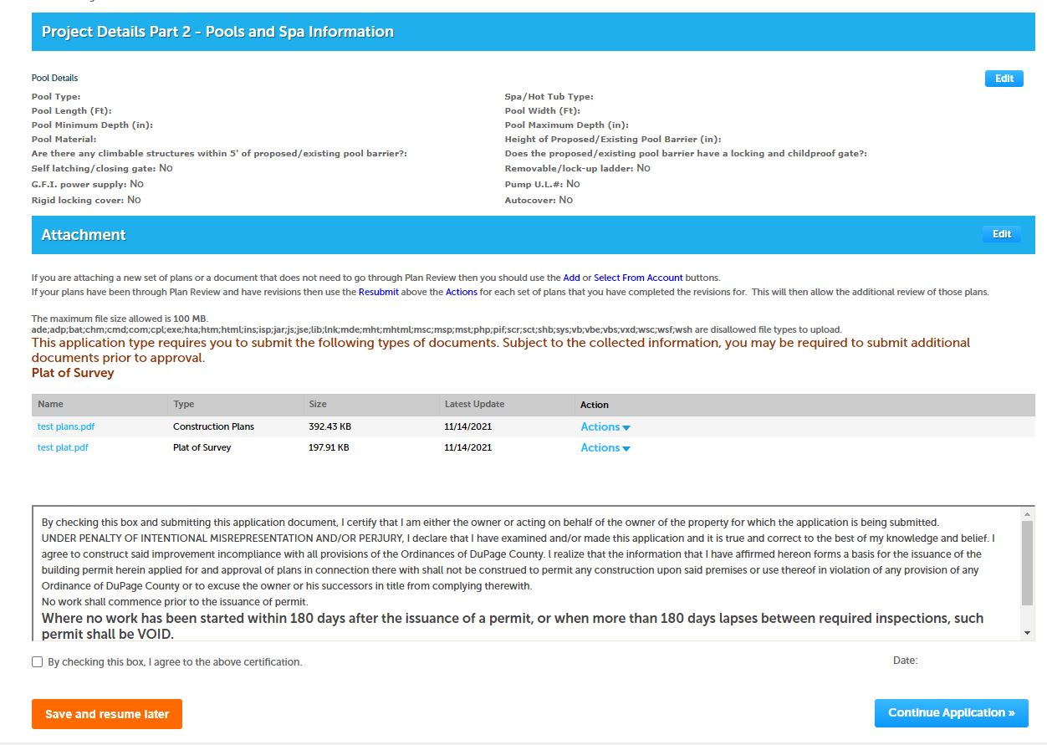
If necessary, use “Add” for more documents.
Review documents. If necessary, choose “Edit” buttons under each heading to revise information. Once complete, read certification information and check box. Complete application with blue button. You will be given the opportunity to pay or defer for a later date.

